Slide 1
GI

Slide 2
SR

Slide 3
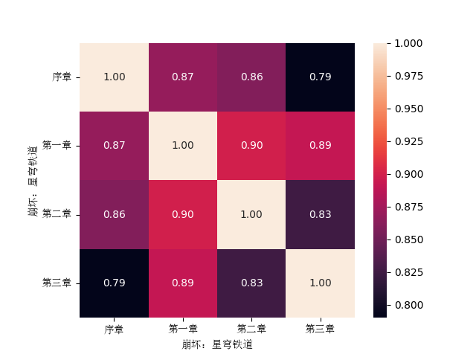
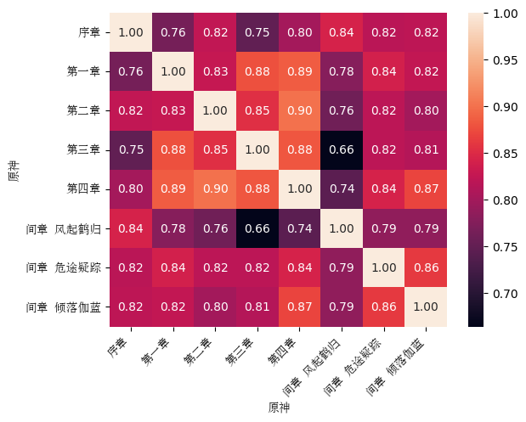
A
B
ABANDONED

